Slide 1
Unit 14 a
Magic moments

Slide 2
Read correctly
ea
ou + ght
aw
ew
/ i: /
/ o: /
/ t /
/ o: /
/ u: /
tea
eat
leave
meat
cheap
thought
bought
ought
brought
fought
saw
draw
claw
paw
raw
crew
flew
grew
drew
blew

Slide 3
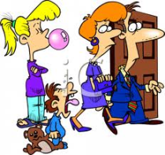
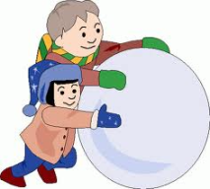
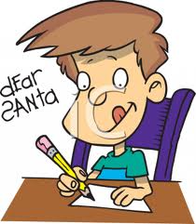
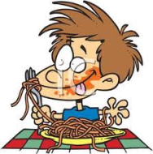
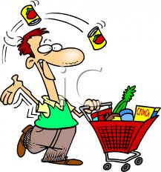
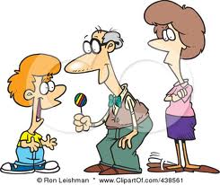
Match
page 110
exercise 1
draw – drew
leave - left
make – made
write - wrote
eat - ate
buy - bought
drink - drank
give - gave
sing - sang

Slide 4
What did you do?
Match
draw
write
buy
drink
eat
food
a picture
juice
pasta
a letter

Slide 5
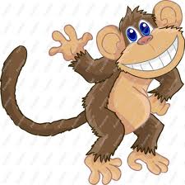
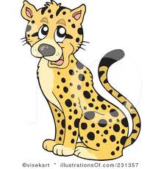
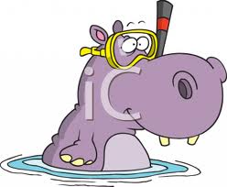
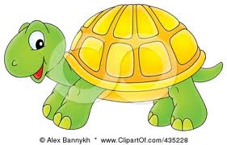
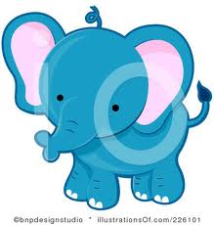
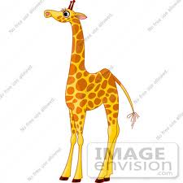
Remember then say.
Use +ER
long
clever
tall
big
fast

Slide 6
GRAMMAR
good – the best
+EST
bad – the worst
bad – the worst
clever – cleverer –the cleverest
pretty – prettier – the prettiest
big – bigger – the biggest

Slide 7
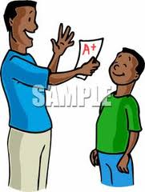
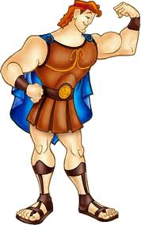
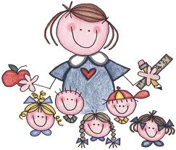
Listen and match
pretty
shy
good
Tell
about
these
children.
a Andy b Babs c Alice
d Ronnie e Joe f Polly
Then tell
about
your
friends.
strong
kind
loud

Slide 8
Home assignment

